Slide 1
A solvable model of Generative Diffusion and the memorization phenomenon
Leonardo Bandera

Slide 2
Agenda
Diffusion Sampling and problem statement
Understanding training dynamics: the original setting
First line of research: towards a more realistic architecture
Second line of research: structured data

Slide 3
Generative Diffusion

Slide 4
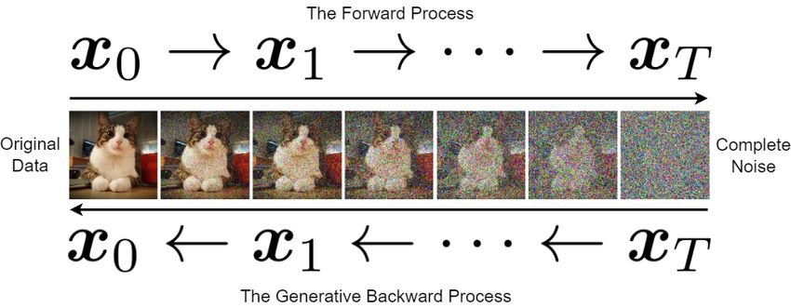

Slide 5
Score-based Diffusion
Forward process: $\frac{dx}{dt}=-x(t)+η(t)$
Reversed process: $\frac{dx}{dτ}=x(τ)+2∇log{\overset{˜}{P}}_{τ}(x)+\overset{˜}{η}(τ)$
The score $S(x,t)=∇logP_{t}(x)$ is unknown… we learn it!
$$L_{λ}(θ)=\frac{1}{n}\overset{n}{\underset{μ=1}{∑}}E_{t∼Q(t)}E_{ξ∼N(0,I_{d})}{∥{\overset{̂}{S}}^{θ}(x_{t}^{μ}(ξ),t)+\frac{ξ}{\sqrt{Δ_{t}}}∥}^{2}$$

Slide 6
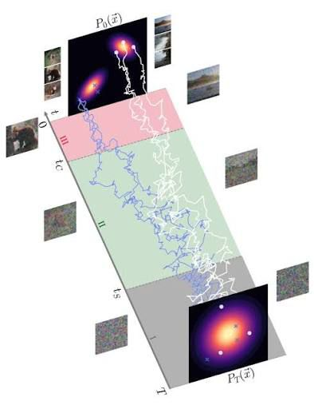
Problem: sampling with the empirical loss minimizer leads to memorization!
Giulio Biroli, Tony Bonnaire, Valentin de Bortoli, and Marc Mézard. Dynamical regimes of diffusion models. Nature Communications, 15(1):9957, nov 2024

Slide 7
Why real diffusion systems avoid this degeneracy?
Architectural constraints
Training dynamics

Slide 8
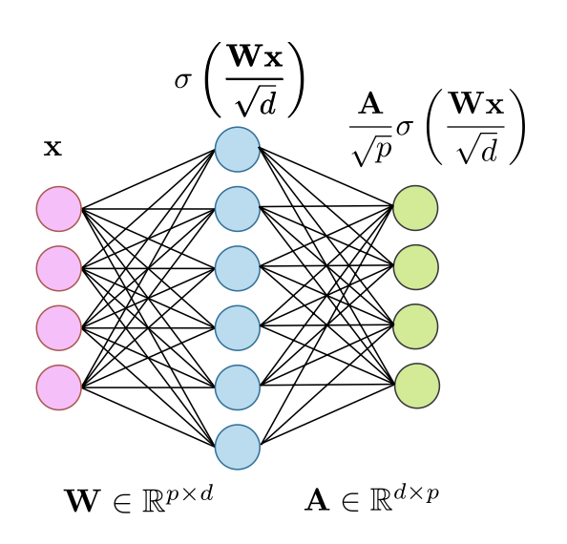
The original setting
Gaussian data
One RFNN per time
Tony Bonnaire, Raphaël Urfin, Giulio Biroli, and Marc Mézard. Why diffusion models don’t memorize: The role of implicit dynamical regularization in training. arXivpreprint arXiv:2505.17638, 2025

Slide 9
Gradient Flow
$$\overset{·}{A}(τ)=-2Δ_{t}\frac{d}{p}AU-\frac{2d\sqrt{Δ_{t}}}{\sqrt{p}}V^{⊤}$$
where
$$U=\frac{1}{n}\overset{n}{\underset{ν=1}{∑}}E_{ξ}[σ(\frac{Wx_{t}^{ν}(ξ)}{\sqrt{d}})σ(\frac{Wx_{t}^{ν}(ξ)}{\sqrt{d}})^{⊤}]$$
The timescales of the training dynamics are given by the inverse eigenvalues of the matrix $Δ_{t}\frac{d}{p}U$ !

Slide 10
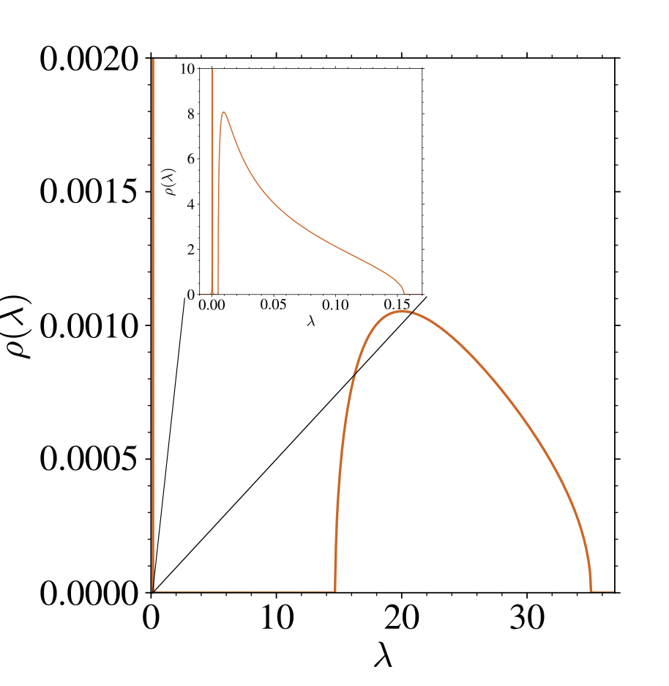
$U$ spectrum
Stieltjes transform
GEP
Replica
Two bulks!

Slide 11
What’s happening at the metrics at the timescales associated to the bulks?

Slide 12
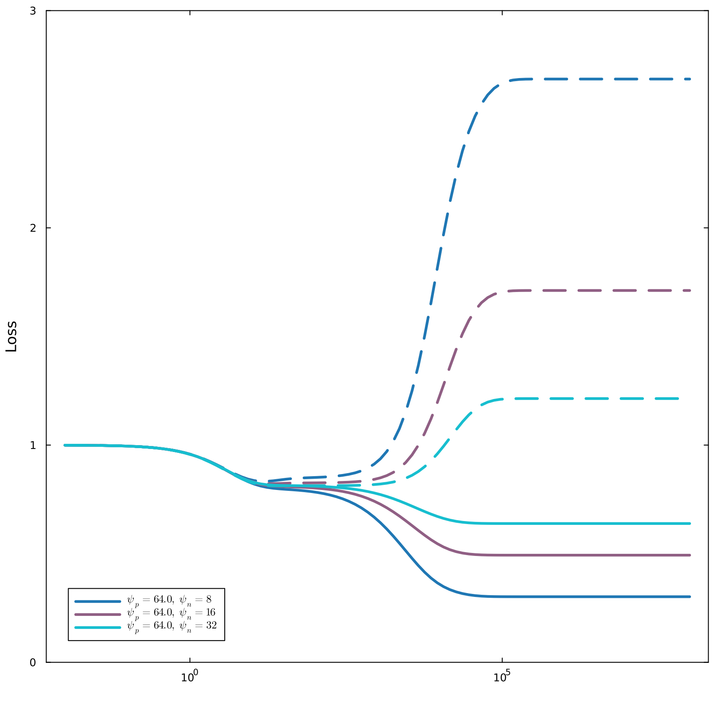
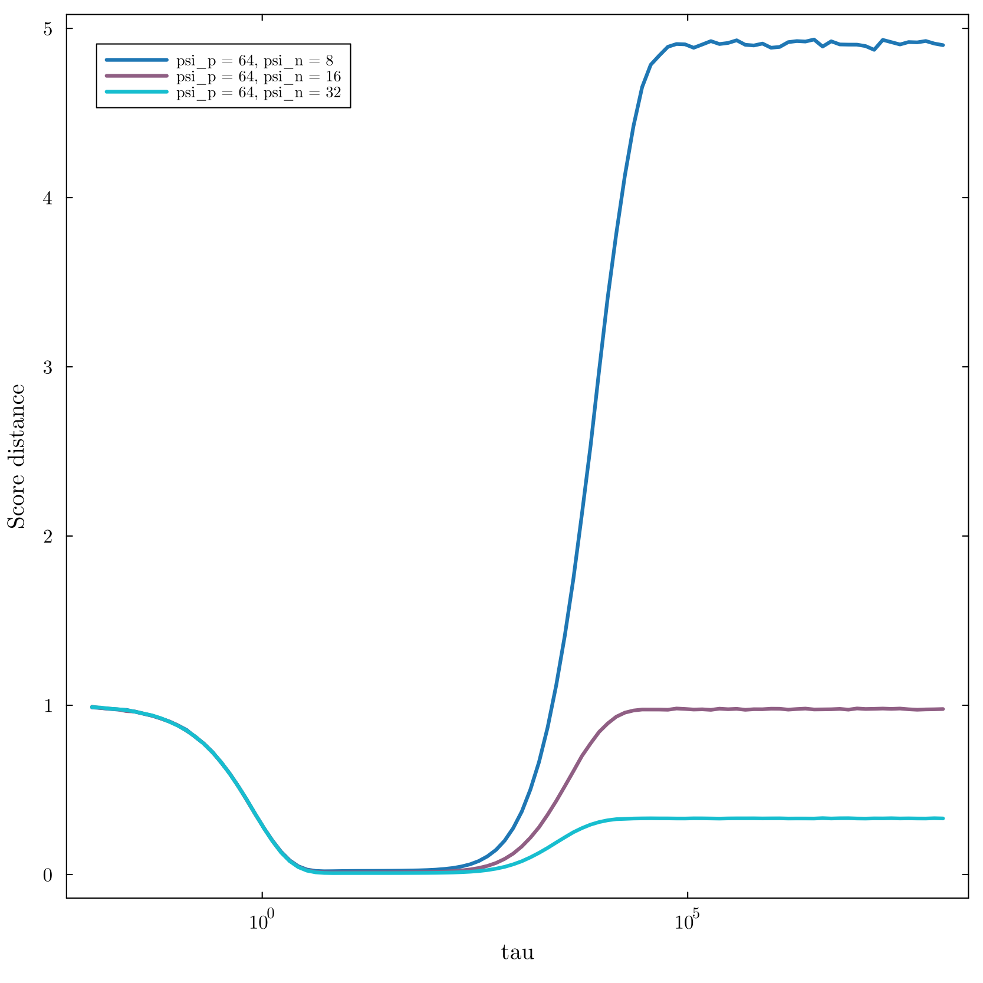

Slide 13
Time Integrated RFNN
$$S_{A}(x,t)=α_{t}\frac{A}{\sqrt{p}}σ\left(\frac{Wx}{\sqrt{d}}+tb\right)+β_{t}x$$
$$L(A,\{{x_{i}}^{ν}\})=\frac{1}{n}\overset{n}{\underset{ν=1}{∑}}\frac{1}{d}E_{ξ,t}∥\sqrt{Δ_{t}}S_{A}(x_{t}^{ν}(ξ),t)+ξ∥^{2}$$

Slide 14
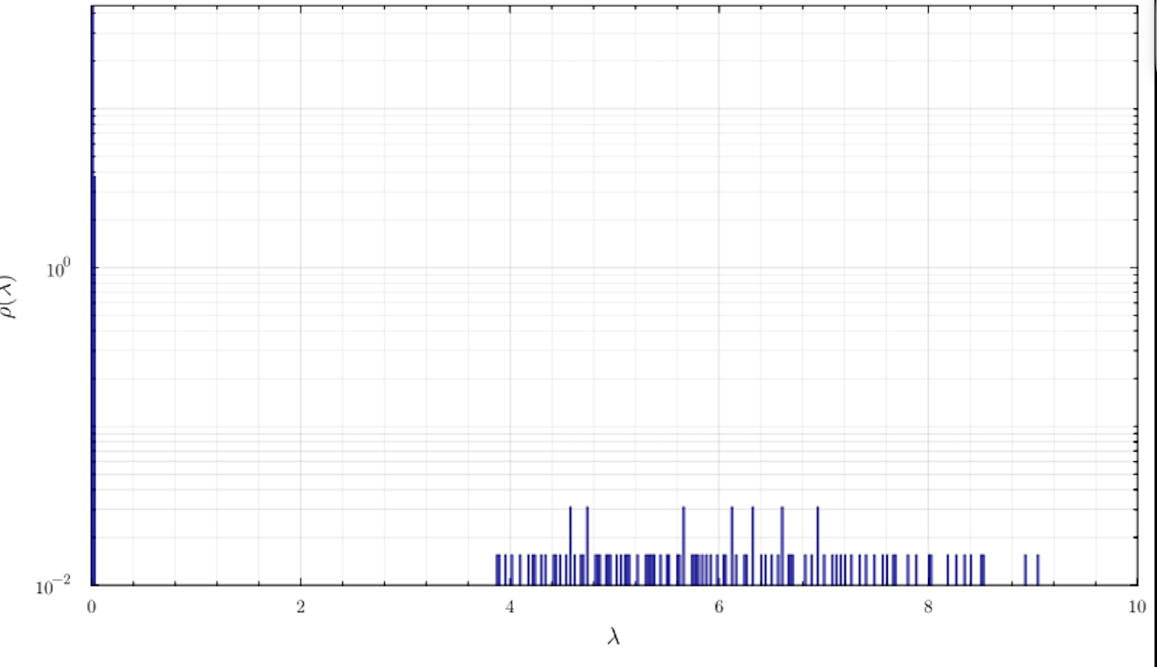
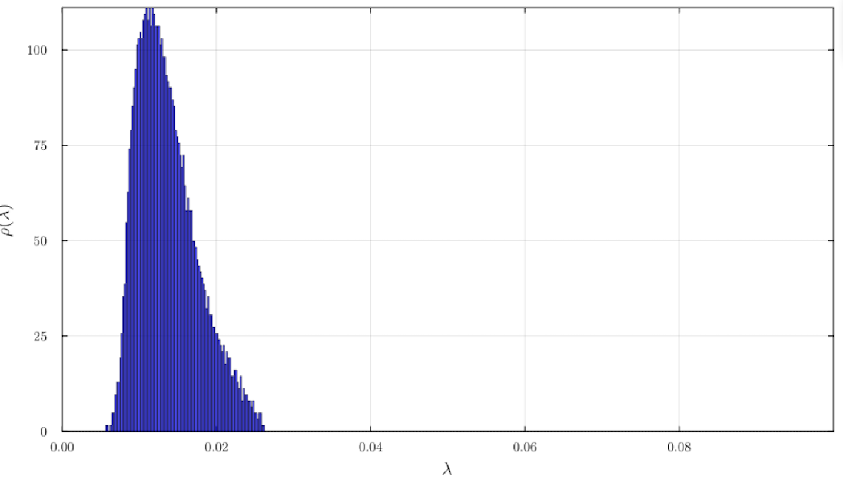
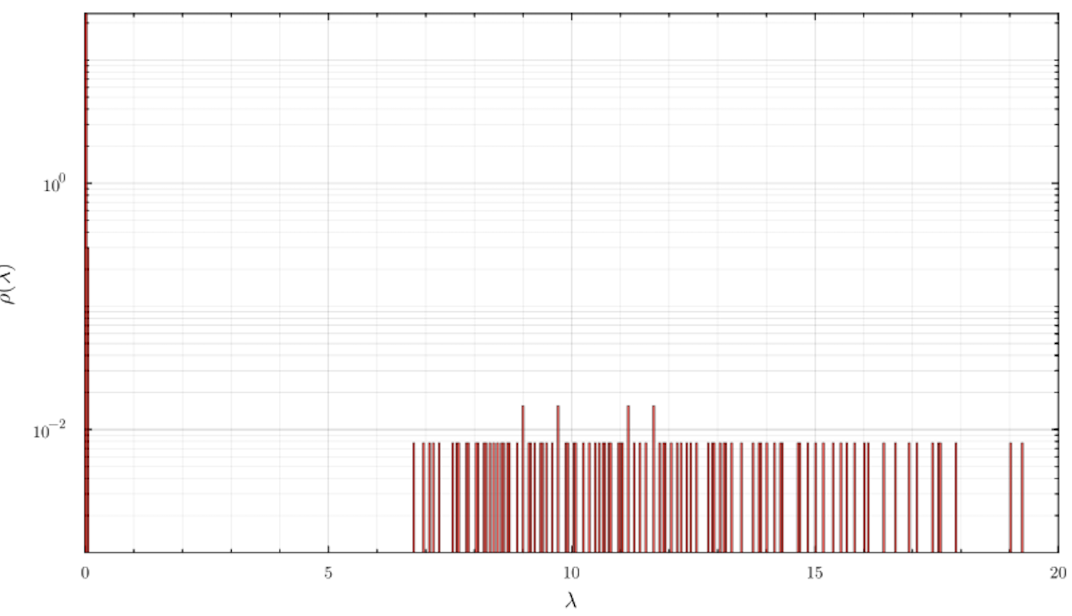
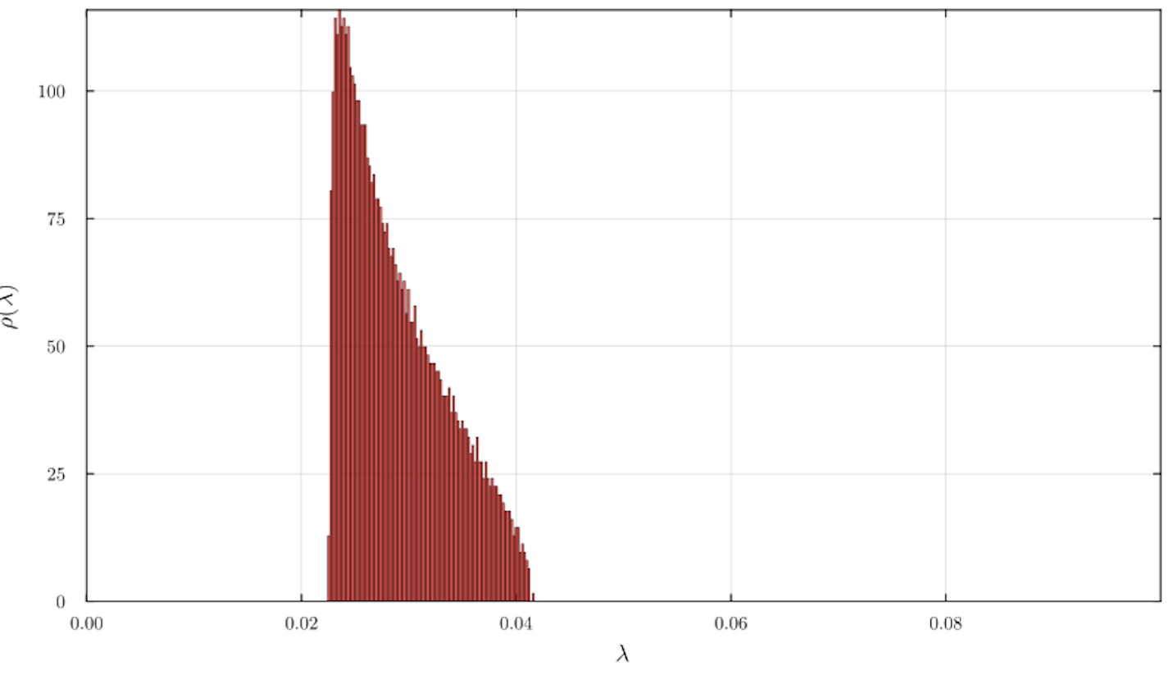
Same phenomenology
Time integration brakes GEP: we cannot compute $U$ spectrum!

Slide 15
MoG Data
$$P_{0}=\frac{1}{2}N(m,σ_{x}^{2}I_{d})+\frac{1}{2}N(-m,σ_{x}^{2}I_{d})$$
or equivalently
$$x^{μ}=c^{μ}m+σ_{x}z^{μ}$$

Slide 16
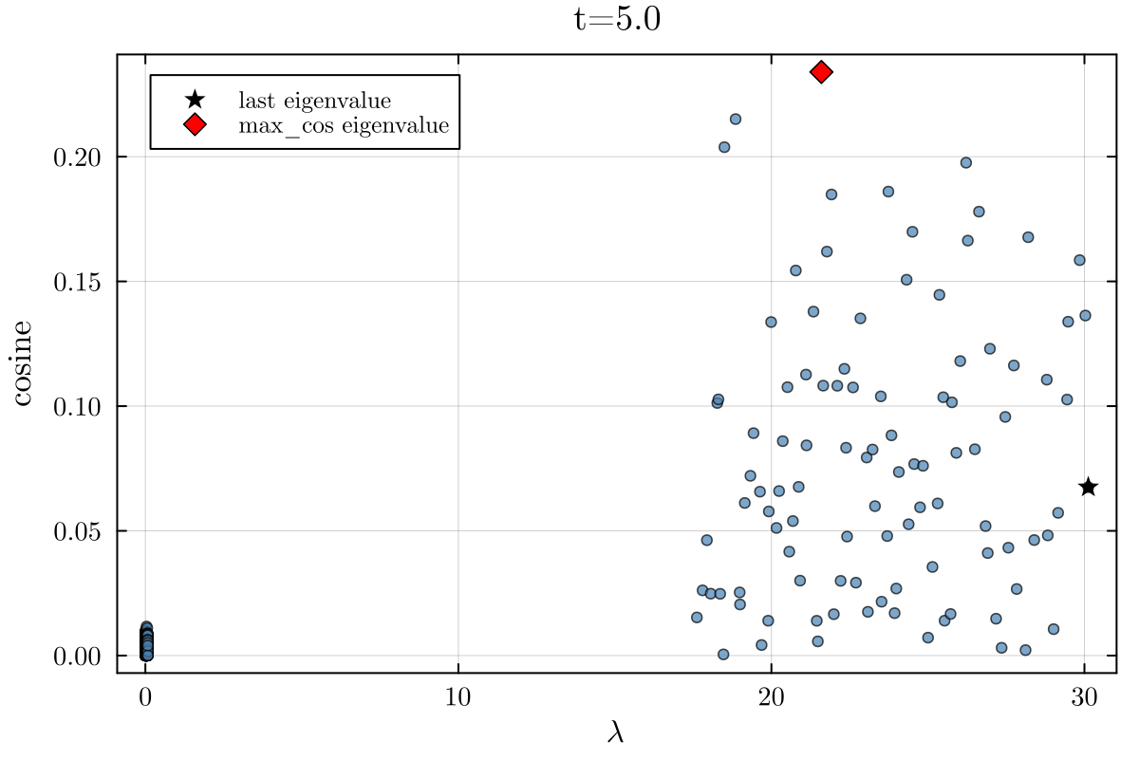
Phenomenology:
$U$ spectrum BBP transition

Slide 17
GEP holds!
$U_{GEP}$ for MoG data is $U_{GEP}$ for gaussian data plus rank-1 terms: the bulks are the same!
We must focus on the outlier…
Brandon Livio Annesi, Dario Bocchi, and Chiara Cammarota. Overparametrization
bends the landscape: Bbp transitions at initialization in simple neural networks.
arXiv preprint arXiv:2510.18435, 2025. Submitted on 21 Oct 2025

Slide 18
It’s a matter of gaussian averages!
We need to compute this:
$${\overline{G}}_{ij}=\lim_{n→0}E_{x}∫\overset{n}{\underset{a=1}{∏}}dψ^{a}exp\left[-\frac{1}{2}\underset{a}{∑}(ψ^{a})^{T}(zI_{N}-U)ψ^{a}\right]ψ_{i}^{1}ψ_{j}^{1}$$
Wick theorem to reduce averages over many fields to averages of pairs
Feynman diagrams to keep track of all possible pairings and interactions between different gaussian fields

Slide 19
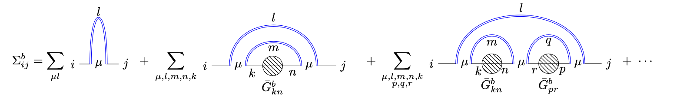
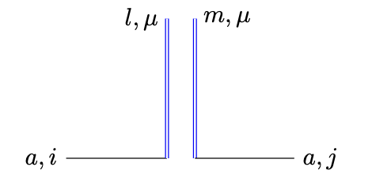
We get to a self-consistent equation for ${\overline{G}}_{ij}$ :
solving it gives the bulks
the condition for the outlier is setting a denominator to zero

Slide 20
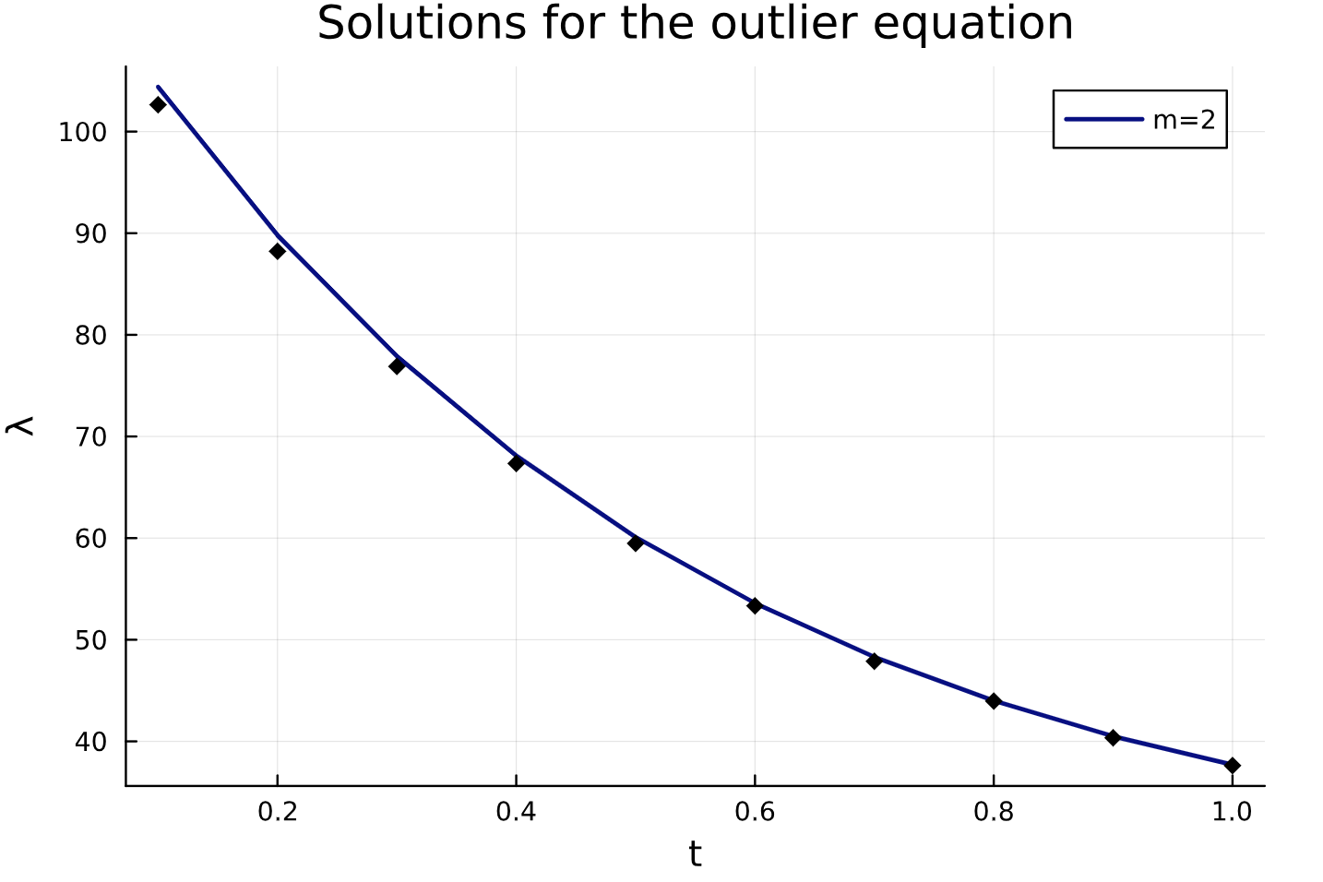

Slide 21
This is interesting at two levels:
Diffusion dynamics: what’s happening at trajectories at transition time?
Training dynamics: what’s happening at the training metrics at the timescale associated to the outlier?

Slide 22
But…
… a legit doubt:

Slide 23
Can RFNN learn a mixture?

Slide 24
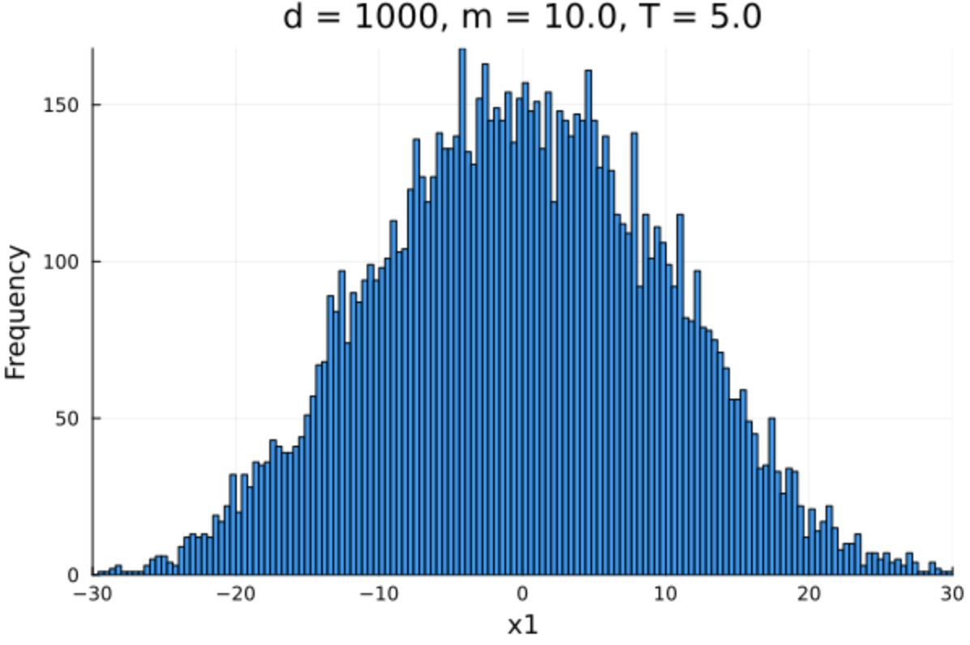
It depends on the Gaussians separation!
If $∥m∥∼O(1)$ the random features score is approximately linear, so the backward process can at most produce a gaussian distribution!

Slide 25
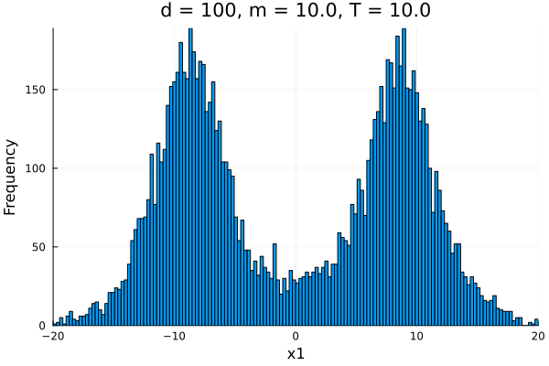
If $∥m∥∼O(\sqrt{d})$ the random features score is non linear, and we can sample effectively from a mixture.

Slide 26
Conclusions

Slide 27
The behavior of the dominant eigenvalue reveals the point (in terms of t and τ) at which the diffusion process becomes sensitive to the informative direction.
Non-separated regime: the process cannot recover the bimodal structure and diffusion collapses to a single component whose variance aligns with the signal direction
Well-separated regime: the process recovers the multimodal structure and separates the modes

